Slide 1
A PREDICTIVE ANALYTICS APPROACH FOR CHRONIC KIDNEY DISEASE DETECTION USING MACHINE LEARNING
CSE7101- Capstone Project
Final Review
Batch Number:CSE_08
Under the Supervision of,
Ms. SHREELATHA PK
Assistant Professor
School of Computer Science and Engineering
Presidency University
Roll Number | Student Name
20221CSE0730 | VINUTHA AH
20231CSE3039 | SHIVANANDA SHETTY AP
20231CSE3088 | VEERESH V MANVACHAR
Name of the Program: Computer Science and Engineering
Name of the HoD: Dr. Asif Mohammed
Name of the Program Project Coordinator: Dr. Jayavadivel Ravi
Name of the School Project Coordinators: Dr. Sampath A K , Dr. Geetha A

Slide 2
Content
Abstract
Literature Survey
Objective
Existing methods and drawbacks
Proposed methods and feasibility
Architecture Diagram
Module Description
Software Requirements
Timeline(Gantt Chart)
References

Slide 3
Problem Statement Number:PSCS_399
Category :Software
Problem Description:
Chronic Kidney Disease (CKD) often remains undetected until advanced stages, leading to severe complications. Traditional diagnosis is time-consuming and error-prone. There is a need for accurate, automated prediction using machine learning to support early detection and timely treatment.

Slide 4
Abstract
Chronic Kidney Disease (CKD) is one of the most significant public health challenges worldwide, affecting millions of people across all age groups. Early detection of CKD plays a vital role in preventing its progression to kidney failure, which often requires dialysis or transplantation. Traditionally, CKD detection relies on medical tests such as serum creatinine, blood urea levels, blood pressure, and other laboratory findings. However, manual diagnosis is often time-consuming, prone to human error, and may fail to identify patients at early stages. With the increasing availability of clinical datasets and the advancement of data-driven techniques, machine learning (ML) has emerged as a promising solution for building predictive models that can assist healthcare professionals in early CKD detection.

Slide 5
Objective
To study and analyse the problem of CKD detection.
To collect and pre process the dataset for model building.
To perform feature selection and dimensionality reduction.
To address class imbalance in the dataset.
To apply and compare multiple machine learning algorithms.
To optimize the chosen algorithm for best accuracy.
To evaluate the system with appropriate metrics.
To develop a frontend system for real-time user interaction.
To document and present findings in a structured report.

Slide 6
Literature Survey
Machine Learning algorithms such as Logistic Regression, SVM, KNN, and Decision Trees are very popular choices for Chronic Kidney Disease (CKD) prediction owing to their simplicity and effectiveness. Logistic Regression is one of the easiest models to interpret as it bases CKD prediction on statistical probability and it also elucidates the impact of each feature—like blood pressure, serum creatinine, or hemoglobin—on the outcome very clearly. Support Vector Machine (SVM) particularly with the RBF kernel works well in discovering complicated non-linear relations within the clinical datasets and in small data sizes, though, it needs careful parameter tuning like C and gamma. K-Nearest Neighbors (KNN) determines the CKD status of a patient by looking at the most similar previous cases and it is simple and effective with normalized data but it gets gradually slow with larger datasets and is also sensitive to noise. Decision Trees, in contrast, use feature-based splits to classify patients and their rule-based structure makes it easy for medical doctors to interpret the results; still, they may overfit if pruning or regularization is not done. The combined power of these essential learning algorithms results in a strong baseline for CKD prediction and also emphasizes the need of pre-processing, feature selection, and parameter tuning for getting precise results.

Slide 7
Literature Survey Table
No. | Paper | Short Description
Sl. No. | Paper | Short Description
1 | Patil et al. (2019) | Applied Decision Tree and Naïve Bayes on UCI CKD dataset; achieved ~92% accuracy. Performance affected by missing values; highlighted importance of preprocessing.
2 | Gonçalves et al. (2020) | Compared Logistic Regression, Random Forest, and SVM; Random Forest performed best (~95% accuracy). Limitation: class imbalance reduced sensitivity.
3 | Jha et al. (2021) | Used SVM and Random Forest with feature selection; accuracy ~97%. Issue: overfitting due to small dataset size.
4 | Ramakrishnan et al. (2019) | Applied Naïve Bayes and Logistic Regression on UCI CKD dataset; accuracy ~88–90%. Concluded simple models are interpretable but miss subtle patterns.
5 | Reddy et al. (2020) | Experimented with XGBoost and Random Forest; achieved ~98% accuracy with XGBoost using oversampling. Limitation: required careful hyperparameter tuning

Slide 8
Existing Methods
Logistic Regression : Works well for simple linear relationships and is easy to interpret, but it struggles to capture complex nonlinear patterns present in CKD datasets.
Decision Trees : Simple and fast to train, but highly prone to overfitting, especially with small and imbalanced CKD datasets.
Support Vector Machines (SVM):Provides high accuracy and performs well with high-dimensional medical data, but the training time is high and not suitable for very large datasets.
Random Forest : Offers better generalization and stability by combining multiple trees. Performs effectively for CKD prediction but may still be influenced by class imbalance without proper handling.

Slide 9
Drawbacks of Existing Methods
Logistic Regression cannot handle non-linear relationships effectively.
Decision Trees tend to overfit and give unstable results.
SVM requires high computation and careful parameter tuning.
Random Forest performs better but still struggles with imbalanced datasets.

Slide 10
Proposed Methods
Algorithms Used: Random Forest, Logistic Regression,SVM(Suport Vector Machine).
Data Preprocessing: Handling missing values,feature selection.
Evaluation Metrics: Accuracy, Precision, Recall, F1-score, ROC-AUC.

Slide 11
Feasibility Study
Works effectively with publicly available CKD datasets (e.g., UCI CKD
dataset).
Can be deployed in real-time clinical decision support systems.
Scalable for larger healthcare datasets.

Slide 12
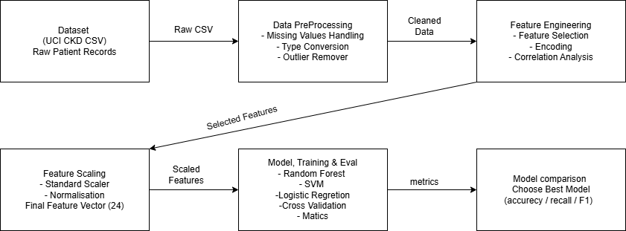
Architecture Diagram

Slide 13
System Design & Architecture
Interaction Flow (summary)
Input Dataset
  Collect CKD patient data (clinical parameters such as age, blood pressure, sugar, serum creatinine, etc.).
Data Preprocessing
  Handle missing values.
  Perform data cleaning and encoding of categorical values.
Feature Selection
  Apply Logistic Regression+ Random Forest to extract the most significant features.
Train-Test Split
  Divide dataset into 80% training and 20% testing for evaluation.

Slide 14
System Design & Architecture
Interaction Flow (summary)
Random Forest Model
  Train multiple decision trees.
  Apply majority voting for final classification.
Evaluation
  Measure model performance using Accuracy, Recall, and AUC (Area Under ROC Curve).
Final Prediction
Output:
  CKD (1) → Patient is predicted to have Chronic Kidney Disease.
  Not CKD (0) → Patient is predicted to be healthy.

Slide 15
Module Description
Data Collection Module
  Collects CKD dataset (UCI CKD dataset or hospital records).
Preprocessing Module
  Handles missing data, normalization, and outlier detection.
Feature Selection Module
  Selects important attributes like age, BP, serum creatinine, blood glucose, etc.
Class Balancing Module
  Solves the issue of class imbalance between CKD and non-CKD cases
  Model Training and Prediction Module
  Algorithms used: Logistic Regression, Random Forest.

Slide 16
Module Description
Prediction Module
  Predicts whether a patient is CKD-positive or not.
Evaluation Module
  Compares models using accuracy, recall, and F1-score.
Deployment Module (Optional)
  Provides a user interface (web/mobile) for real-time predictions.

Slide 17
Software Requirements
Programming Language: Python (3.x)
Libraries: Pandas, NumPy, Scikit-learn, Matplotlib, Seaborn
IDE/Tools: Visual Studio
Deployment: Flask
OS: Windows

Slide 18
Algorithms
Algorithms Used
Random Forest: High accuracy, reduces overfitting, shows feature importance.
SVM: Works well with small/high-dimensional medical data, finds optimal separating hyperplane.
Logistic Regression: Simple baseline model for binary CKD classification.
Decision Tree: Easy to interpret but may overfit.
Preprocessing Algorithms: Missing value handling, encoding, scaling to clean data before training.

Slide 19
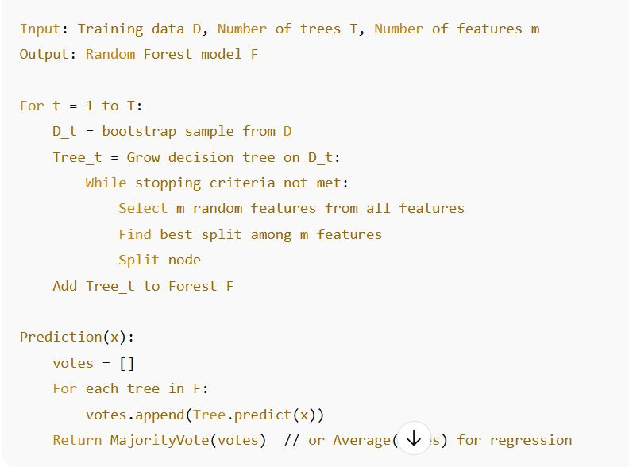
Algorithms
2. Random Forest Classifier
Goal: The core predictive model for classifying whether a patient has CKD or not. Pseudocode:
Algorithm:
Select n bootstrap samples from the training dataset.
For each bootstrap sample:
a. Train a decision tree using the sample.
b. At each split, select a random subset of features m (not all).
c. Choose the best split from those features.
Repeat steps until N decision trees are built.
For prediction:
Each tree gives a class vote.
Final prediction = majority vote (classification) or average (regression).
Flowchart Concept:
Preprocessed Input → Classifier / Pattern Matching → Intent with Confidence → Output Intent or Clarification

Slide 20
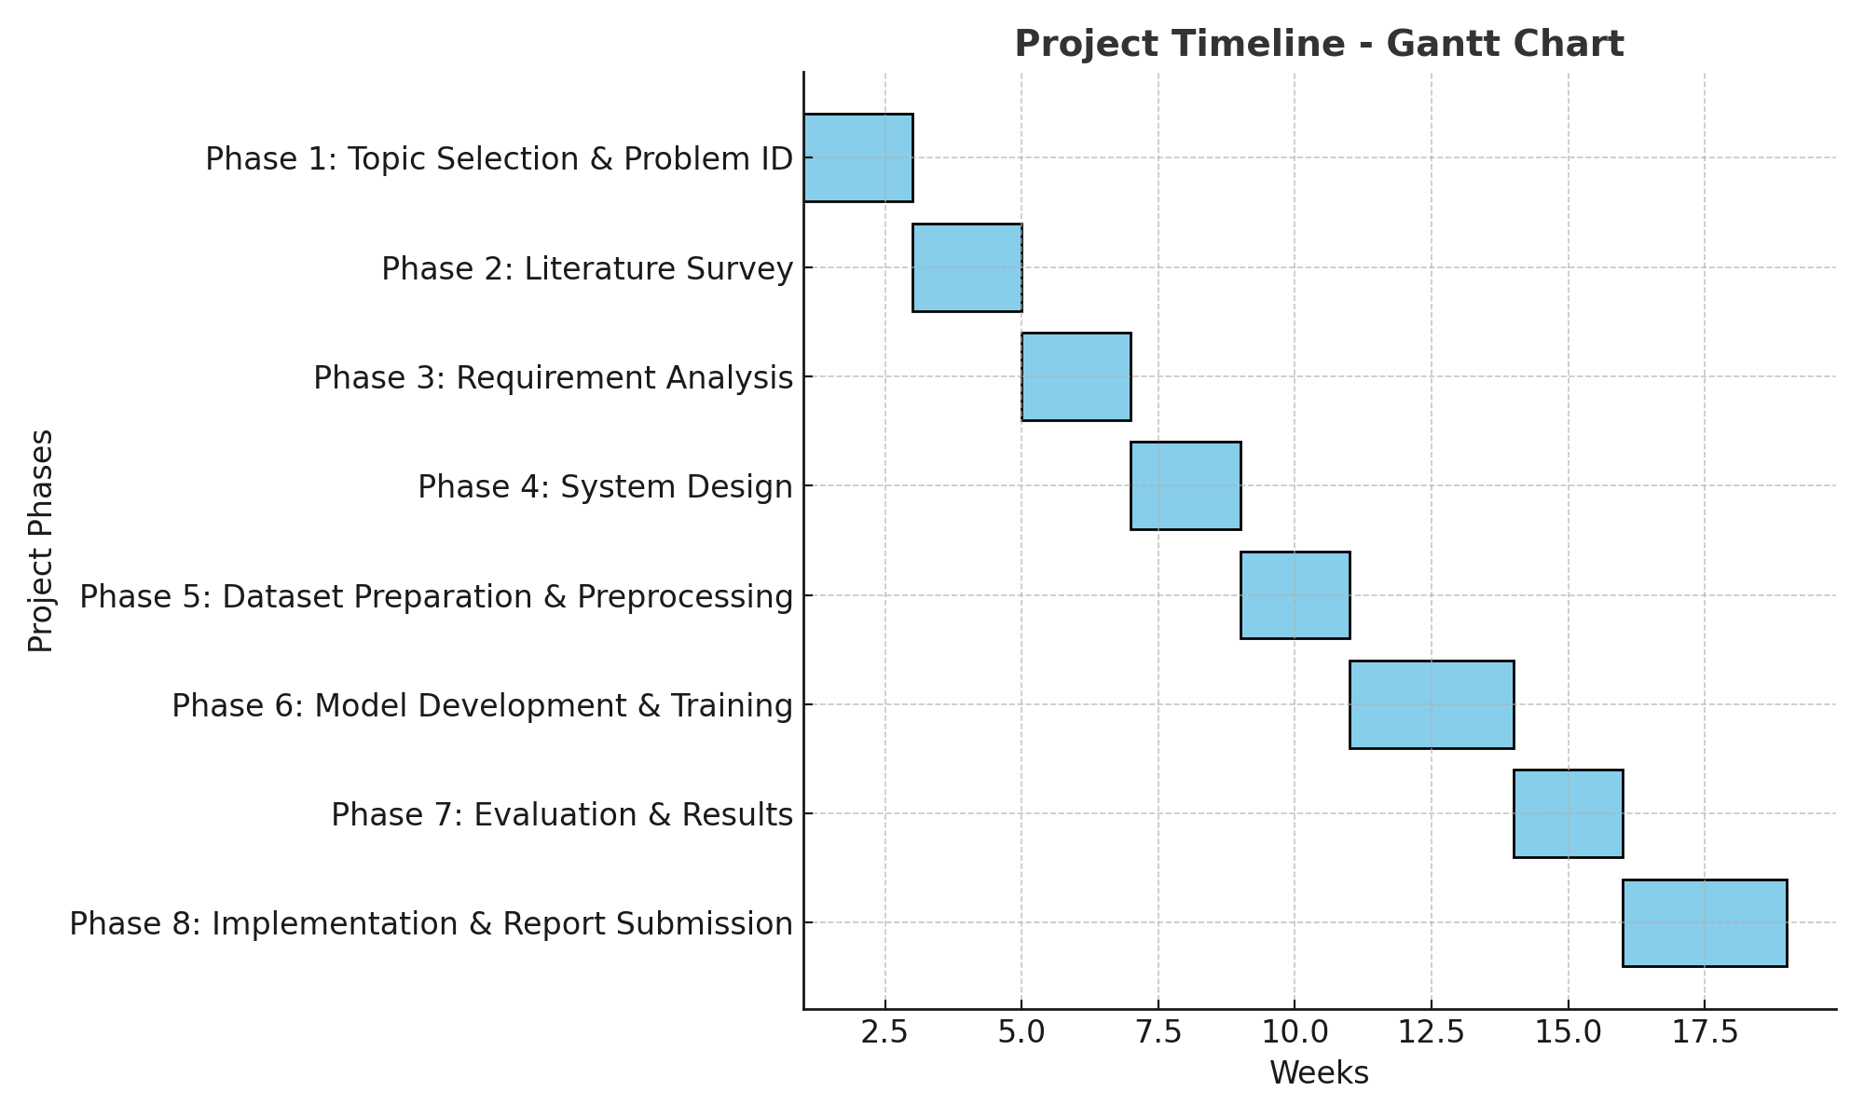
Timeline of the Project (Gantt Chart)

Slide 21
References (IEEE Paper format)
[1] A. Singh, P. Sharma, and R. Kumar, “Chronic Kidney Disease Prediction Using Random Forest Classifier,” Procedia Computer Science, vol. 167, pp. 1980–1989, 2020. doi: 10.1016/j.procs.2020.03.228
[2] G. Jha, R. Arora, and N. Sinha, “A Comparative Study of Machine Learning Models for CKD Prediction,” International Journal of Engineering Research & Technology, vol. 9, no. 6, pp. 426–430, 2020.
[3] S. Al Imran and M. Rahman, “Prediction of Chronic Kidney Disease Using Logistic Regression and Random Forest,” International Journal of Computer Applications, vol. 975, no. 8887, pp. 25–30, 2019.

Slide 22
References (IEEE Paper format)
[4] M. A. Wahab, F. Khalid, and S. A. Malik, “A Novel Hybrid Model for Chronic Kidney Disease Prediction,” IEEE Access, vol. 8, pp. 112594–112602, 2020. doi: 10.1109/ACCESS.2020.3003425
[5] R. M. Elbattah and A. Soliman, “A Data-Driven Approach for Chronic Kidney Disease Detection,” International Conference on Health Informatics, Springer, pp. 45–56, 2019.
[6] R. Tummalapalli, S. Johnson, and A. Misra, “Chronic Kidney Disease Prediction Using Machine Learning Algorithms,” BMC Nephrology, vol. 21, no. 1, pp. 1–12, 2020. doi: 10.1186/s12882-020-02059-6

Slide 23


